Slide 1
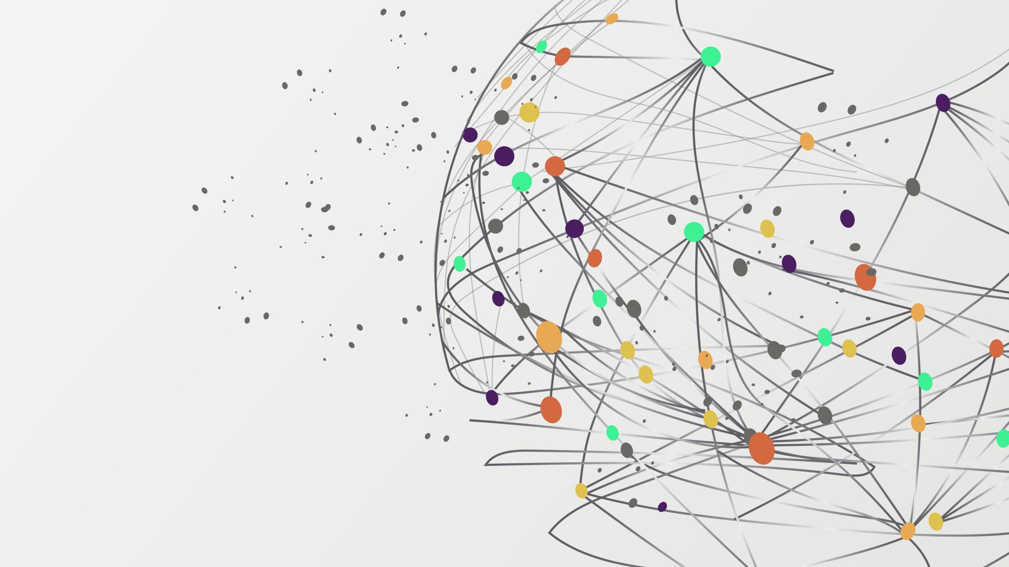
Medical Symptoms Classification
By Sahar Ziv

Slide 2


Background and Motivation
In today's world, there is a significant shortage of family doctors. As a result, many family doctors are overworked and burdened by diagnosing minor and common illnesses, such as coughs or stomach aches.
This overload can lead to fatigue, increasing the risk of misdiagnoses and incorrect treatments.

Slide 3


Imagine a preliminary assessment conducted over the phone, or even better, an AI-powered machine that classifies symptoms based on the patient's self-reported feelings.
This could free up family doctors to focus on more serious conditions,
improving healthcare outcomes for everyone.

Slide 4
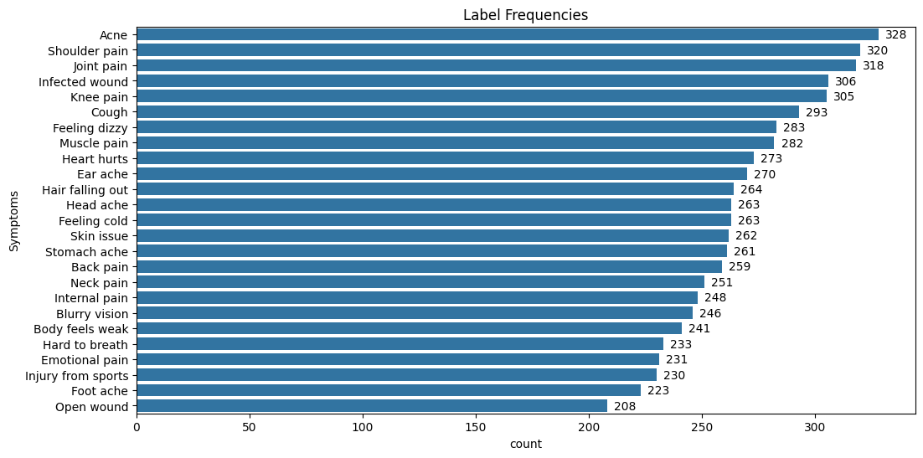
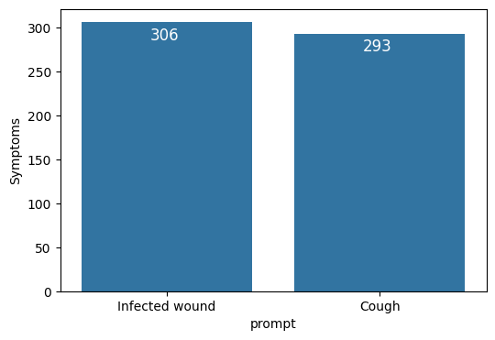
The Data
In order to create such a machine, we need a dataset containing audio files of patients' self-reported problems, each labeled with the corresponding symptom.
And we have just that! Our dataset includes 6661 audio files of patients explaining their problems, classified into 25 different medical symptoms.
We would use the observations labeled “Cough” to represent the minor illnesses and “Infected wound” to represent the major illnesses and we subset 599 observations.

Slide 5
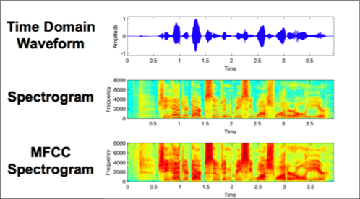
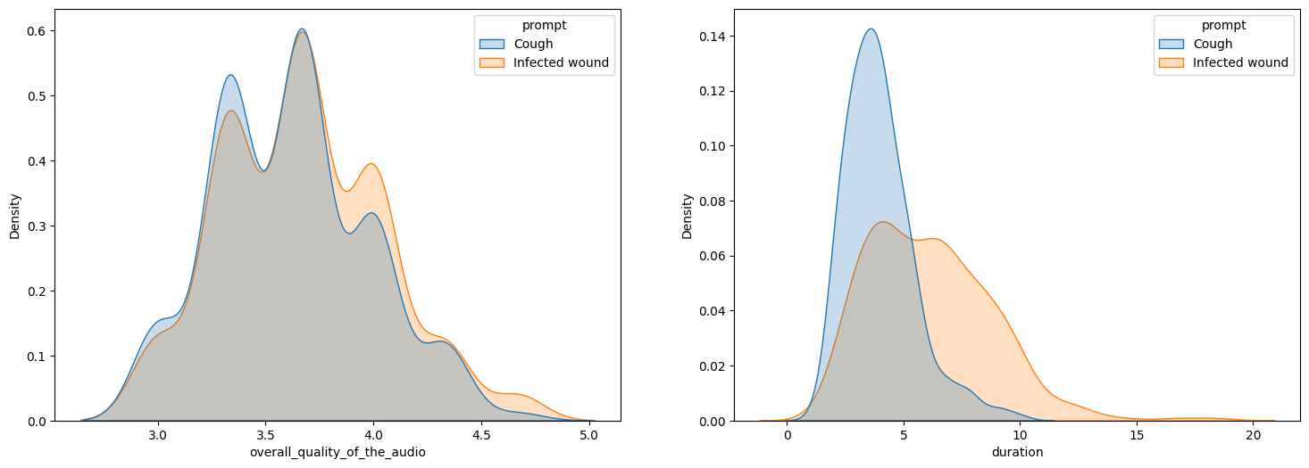
The Data
The features consist of:
4 audio quality scores from the CSV file.
17 features extracted from the audio files:
The duration of the audio file.
13 MFCCs across the signal windows.
The spectral centroid across the signal windows.
The zero-crossing rate across the signal windows.
The root mean square (rms) energy over the signal windows.
For each one the mean and standard deviations across the signal windows were taken. In total, There are 37 continuous features.
Notes:
MFCC – Taking the waveform (Amplitude over time) and windowing, applying Fourier transform, changing the data to Mel-scale, taking the logarithm and applying another Fourier transformation.
Spectral Centroid – Taking each window of the waveform and normalizing the aplitude, then taking the mean over the frequencies (Hz). centroid[t] = sum_k S[k, t] * freq[k] / (sum_j S[j, t]), where S is a magnitude spectrogram, and freq is the array of frequencies (e.g., FFT frequencies in Hz) of the rows of S.
Zero Crossing Rate - is the rate at which a signal changes from positive to zero to negative or from negative to zero to positive.
RMS - Compute root-mean-square (RMS) value for each frame in the spectrogram.

Slide 6
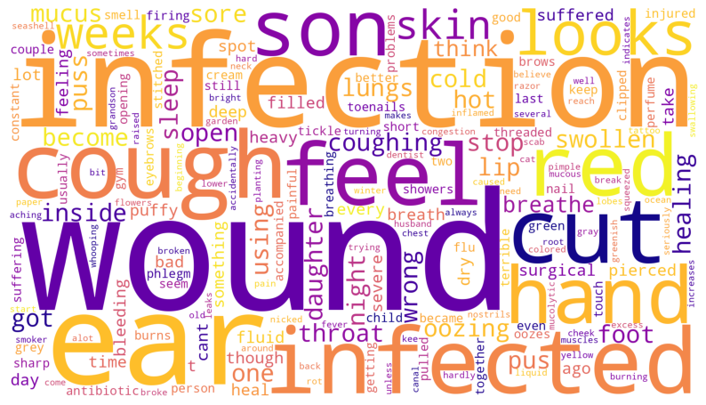
The Data
Moreover, there is a transcript of the self-reported audio file as a feature is the CSV file.
So, we can ask which model is more accurate, classification through the audio files themselves, with features extracted from them, or classification through the words said in the audio file?
Notes:
Spoilers: NLP classification is better!

Slide 7
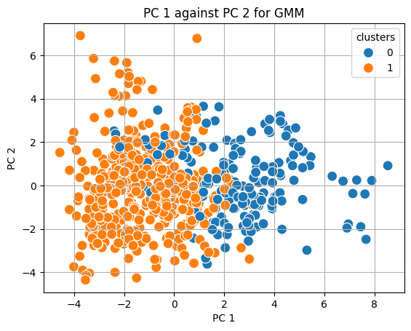
Clustering as Exploratory Data Analysis (EDA)
Various methods of clustering the data in groups were conducted, to learn more about the nature of the data.
The most interesting method was Gaussian Mixture Model (GMM), which resulted in separating the data into two group.
Speakers with heavy Indian accent.
Speakers with light or none Indian accent.

Slide 8
Classification Model and Modeling Process
4 models were compared: Logistic regression with penalty, K-NN, SVM and Classification tree.
3 modeling processes were compared:
One model with all features and without the clustering feature.
Two different models with all the features for each of the clusters.
One model of the features extracted from NLP.
The training set is 70% (419 observations) and the test set is 30% (180 observations)

Slide 9
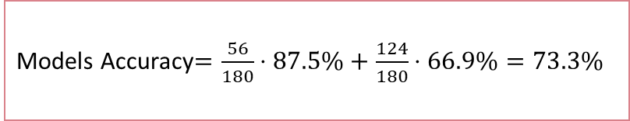
Audio Recordings Classification results
Model |  | Parameters | Accuracy | Sensitivity | Specificity | F1 Score | Train Accuracy
Without respect to clusters n=180 | LASSO Logistic Regression | "C": exp{-0.98} | 71.7% | 75.5% | 67.4% | 71.2% | 70.2%
 | KNN | "K": 67 | 67.8% | 73.4% | 61.6% | 67% | 64.7%
 | SVM - Radial Kernel | "C": exp{-0.2}; "Gamma": 0.1 | 68.9% | 70.2% | 67.4% | 68.8% | 90.2%
 | Classification Tree - Entropy Metric | "Max Depth": 2; “Min Samples Leaf”: 5 | 73.9% | 93.6% | 52.3% | 67.1% | 70.2%
Within the heavy accent speakers n=56 | LASSO Logistic Regression | "C": exp{-0.16} | 83.9% | 85.2% | 82.8% | 84.0% | 76.2%
 | KNN | "K": 51 | 64.3% | 81.5% | 48.3% | 60.7% | 62.3%
 | SVM - Linear Kernel | "C": exp{-0.4} | 87.5% | 85.2% | 89.7% | 87.4% | 77.7%
 | Classification Tree - Entropy Metric | "Max Depth": 5; "Min Samples Leaf": 7 | 64.2% | 63.0% | 65.5% | 64.2% | 86.2%
Within the light accent speakers n=124 | LASSO Logistic Regression | "C": exp{-1} | 66.9% | 75.9% | 60.0% | 67.0% | 73.4%
 | KNN | "K": 47 | 61.3% | 79.6% | 47.1% | 59.2% | 69.6%
 | SVM - Radial Kernel | "C": exp{-0.7}; "Gamma": 0.01 | 66.1% | 88.9% | 48.6% | 62.8% | 73.0%
 | Classification Tree - Entropy Metric | "Max Depth": 6; "Min Samples Leaf": 6 | 64.5% | 68.5% | 61.4% | 64.8% | 83.0%
Models Accuracy$=\frac{56}{180}⋅87.5\%+\frac{124}{180}⋅66.9\%=73.3\%$

Slide 10

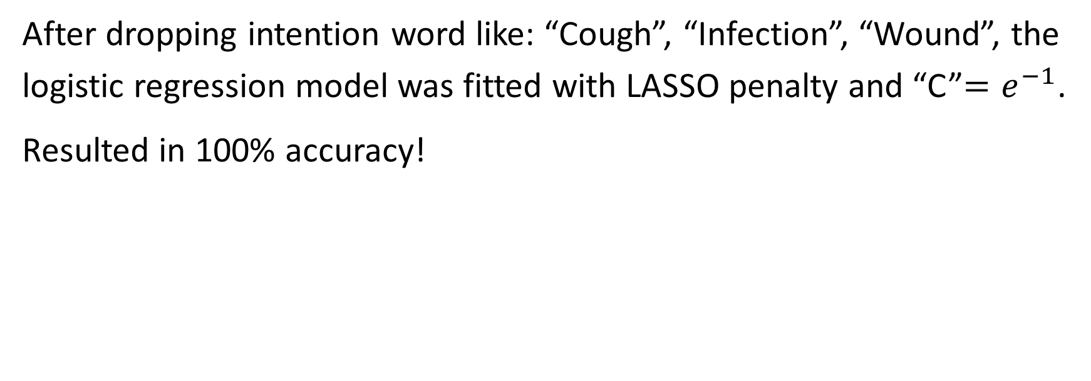
NLP Classification Model
After dropping intention word like: “Cough”, “Infection”, “Wound”, the logistic regression model was fitted with LASSO penalty and “C”$=e^{−1}$.
Resulted in 100% accuracy!

Slide 11

The Technical side
Diving in the data engineering and Models

Slide 12
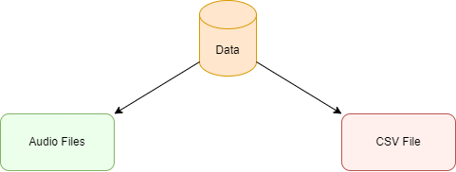
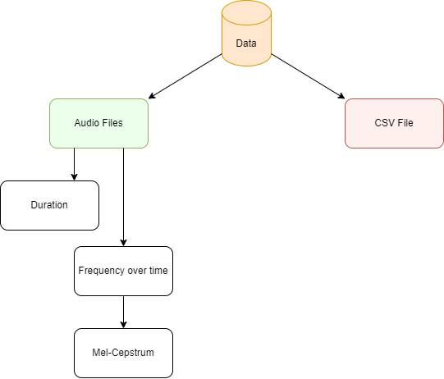
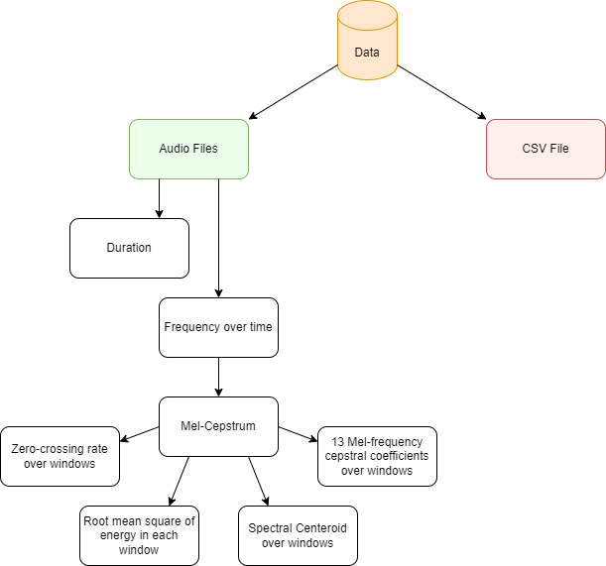
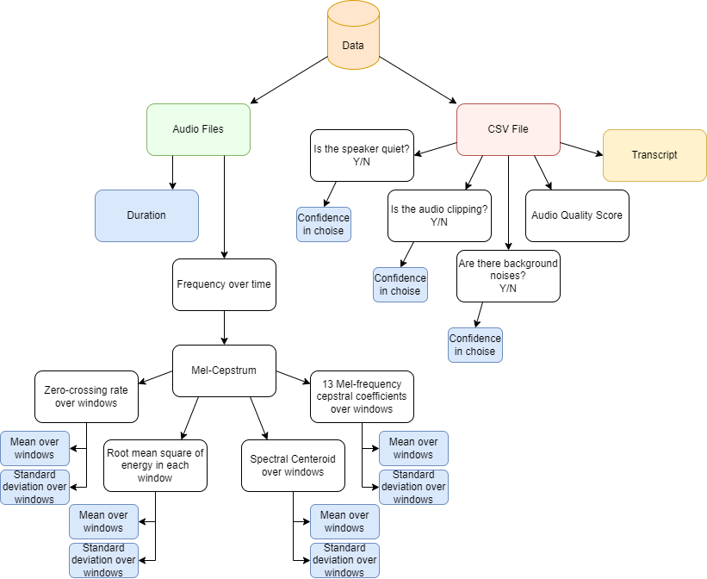
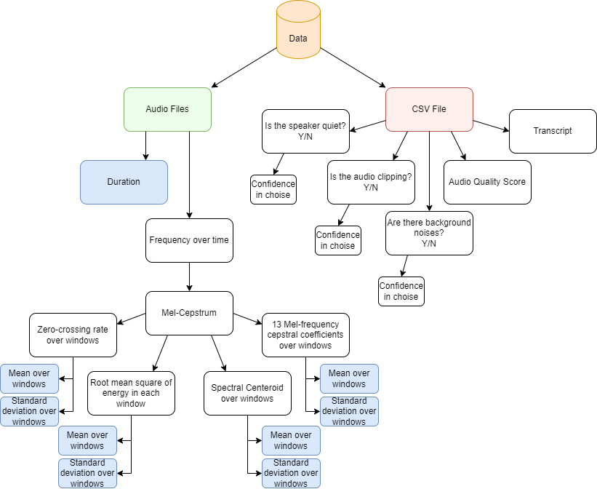
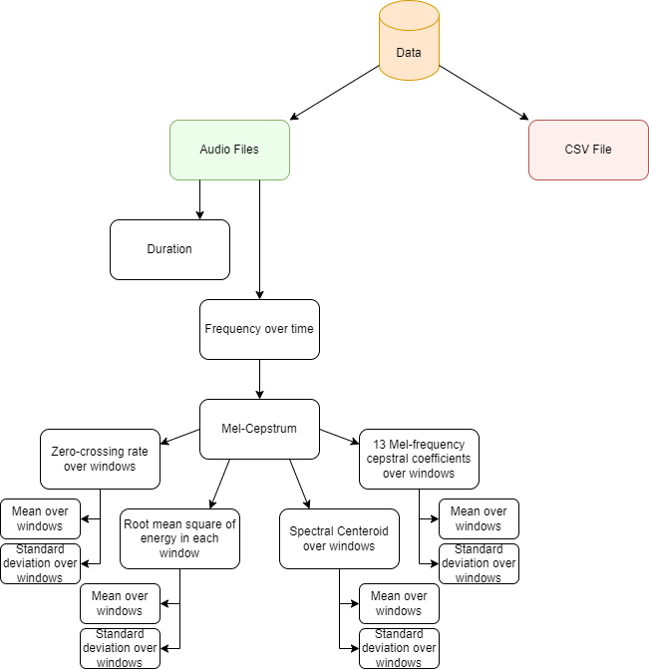
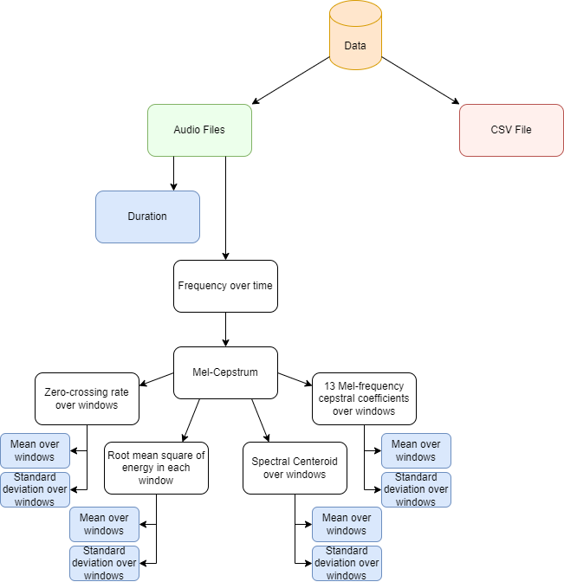
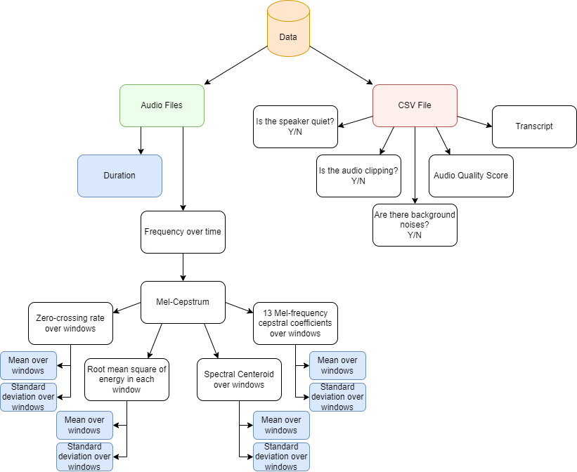
Back to Feature Engineering

Slide 13
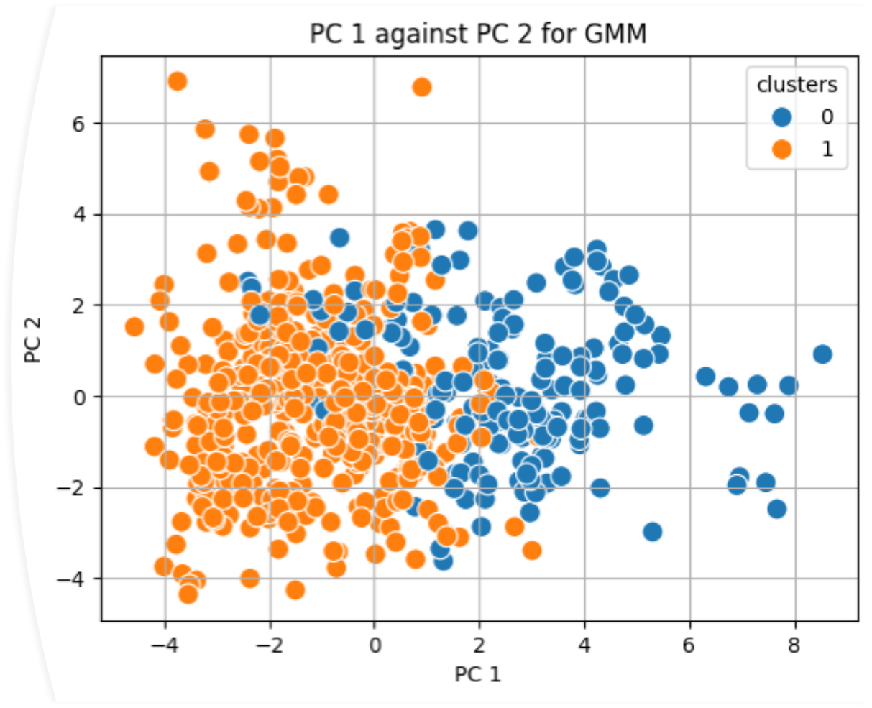
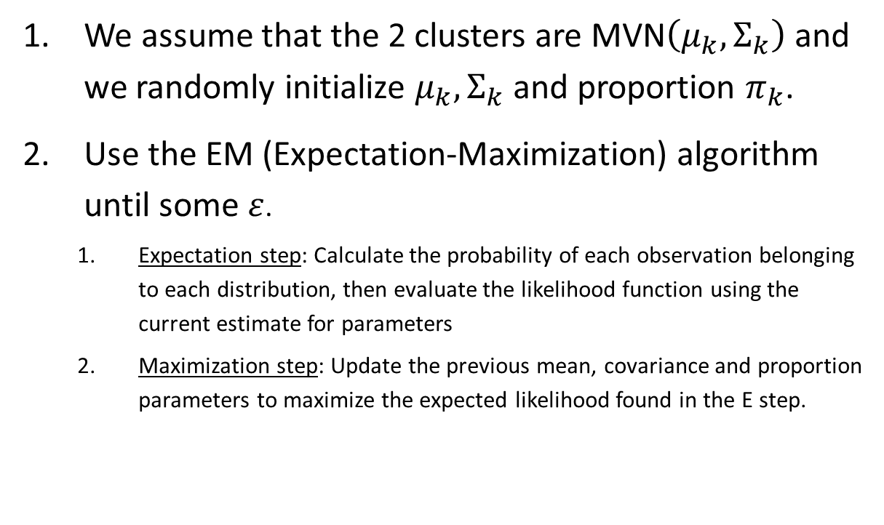
Gaussian Mixture Model (GMM)
We assume that the 2 clusters are MVN$\left(μ_{k},Σ_{k}\right)$ and we randomly initialize $μ_{k}, Σ_{k}$ and proportion $π_{k}$.
Use the EM (Expectation-Maximization) algorithm until some $ε$.
Expectation step: Calculate the probability of each observation belonging to each distribution, then evaluate the likelihood function using the current estimate for parameters
Maximization step: Update the previous mean, covariance and proportion parameters to maximize the expected likelihood found in the E step.

Slide 14
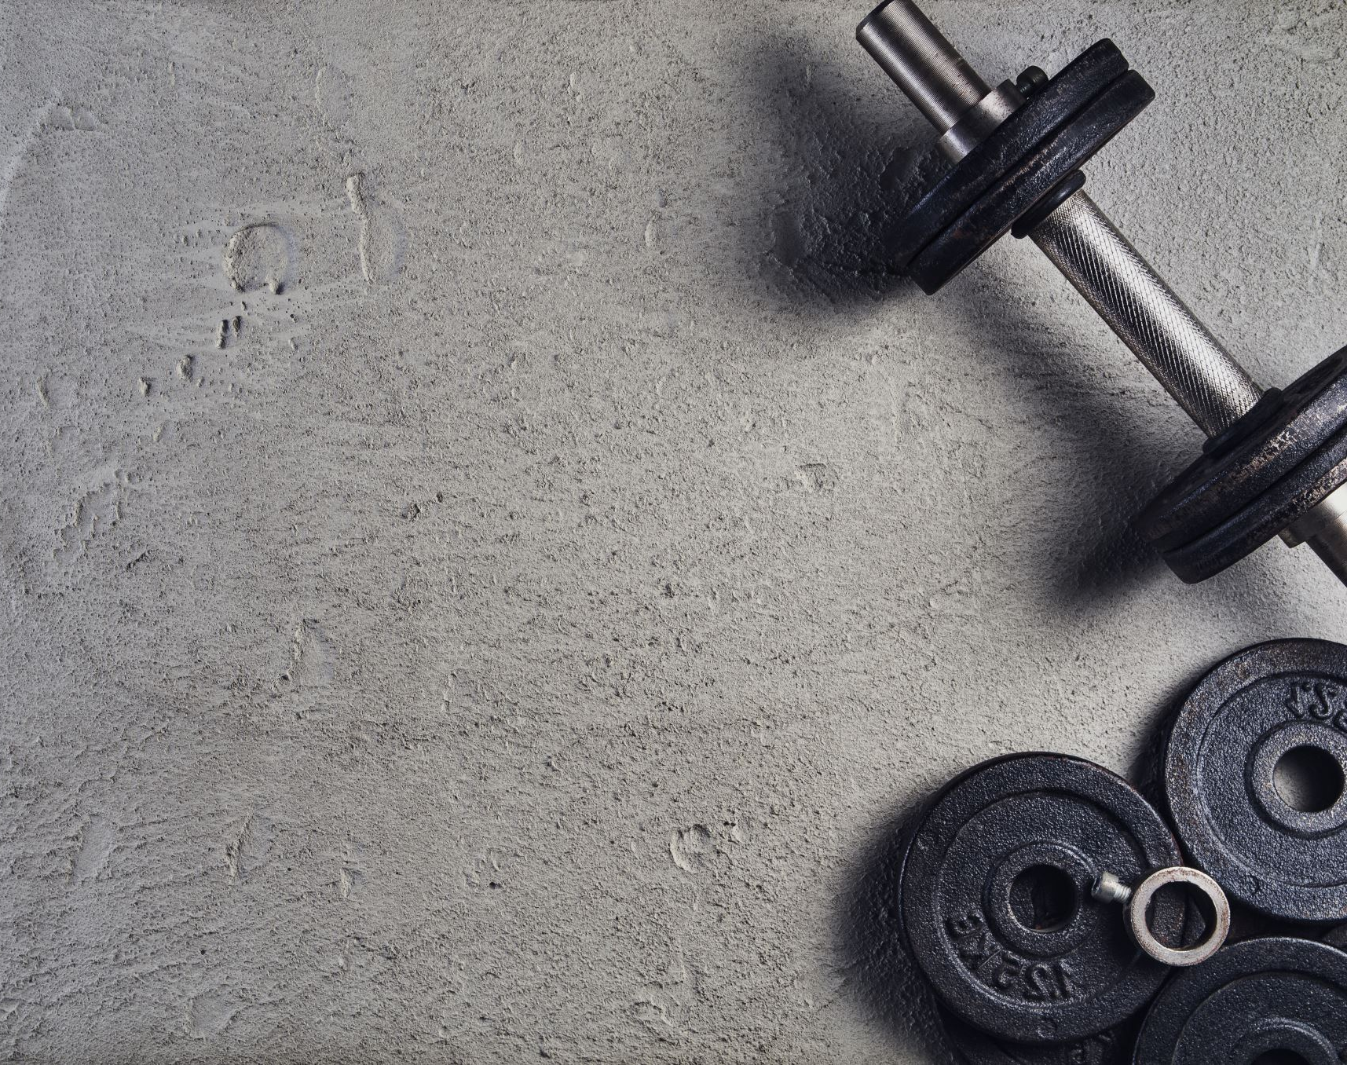
Training the Models
Each classification model had been 10-fold cross validated over the train data (70%) which been scaled and chose the most accurate parameters using a parameter grid:
Logistic Regression
Penalty: LASSO / Ridge
C: exp{-1} to 1
K-NN
K: Odds numbers from 3 to n
SVM
Kernel: Linear / Polynomial / Radial
C: exp{-1} to 1
Degree: (for polynomial only) 3 to 6
Gamma: (for radial only) [0.001,0.01,0.1,1]
Classification Tree
Maximum Depth: 3 to 7
Minimum Samples in Leaf: 5 to 8
Criterion: Gini / Entropy

Slide 15
Audio Recordings Classification results
Model |  | Parameters | Accuracy | Sensitivity | Specificity | F1 Score | Train Accuracy
Without respect to clusters n=180 | LASSO Logistic Regression | "C": exp{-0.98} | 71.7% | 75.5% | 67.4% | 71.2% | 70.2%
 | KNN | "K": 67 | 67.8% | 73.4% | 61.6% | 67% | 64.7%
 | SVM - Radial Kernel | "C": exp{-0.2}; "Gamma": 0.1 | 68.9% | 70.2% | 67.4% | 68.8% | 90.2%
 | Classification Tree - Entropy Metric | "Max Depth": 2; “Min Samples Leaf”: 5 | 73.9% | 93.6% | 52.3% | 67.1% | 70.2%
Within the heavy accent speakers n=56 | LASSO Logistic Regression | "C": exp{-0.16} | 83.9% | 85.2% | 82.8% | 84.0% | 76.2%
 | KNN | "K": 51 | 64.3% | 81.5% | 48.3% | 60.7% | 62.3%
 | SVM - Linear Kernel | "C": exp{-0.4} | 87.5% | 85.2% | 89.7% | 87.4% | 77.7%
 | Classification Tree - Entropy Metric | "Max Depth": 5; "Min Samples Leaf": 7 | 64.2% | 63.0% | 65.5% | 64.2% | 86.2%
Within the light accent speakers n=124 | LASSO Logistic Regression | "C": exp{-1} | 66.9% | 75.9% | 60.0% | 67.0% | 73.4%
 | KNN | "K": 47 | 61.3% | 79.6% | 47.1% | 59.2% | 69.6%
 | SVM - Radial Kernel | "C": exp{-0.7}; "Gamma": 0.01 | 66.1% | 88.9% | 48.6% | 62.8% | 73.0%
 | Classification Tree - Entropy Metric | "Max Depth": 6; "Min Samples Leaf": 6 | 64.5% | 68.5% | 61.4% | 64.8% | 83.0%
Models Accuracy$=\frac{56}{180}⋅87.5\%+\frac{124}{180}⋅66.9\%=73.3\%$

Slide 16
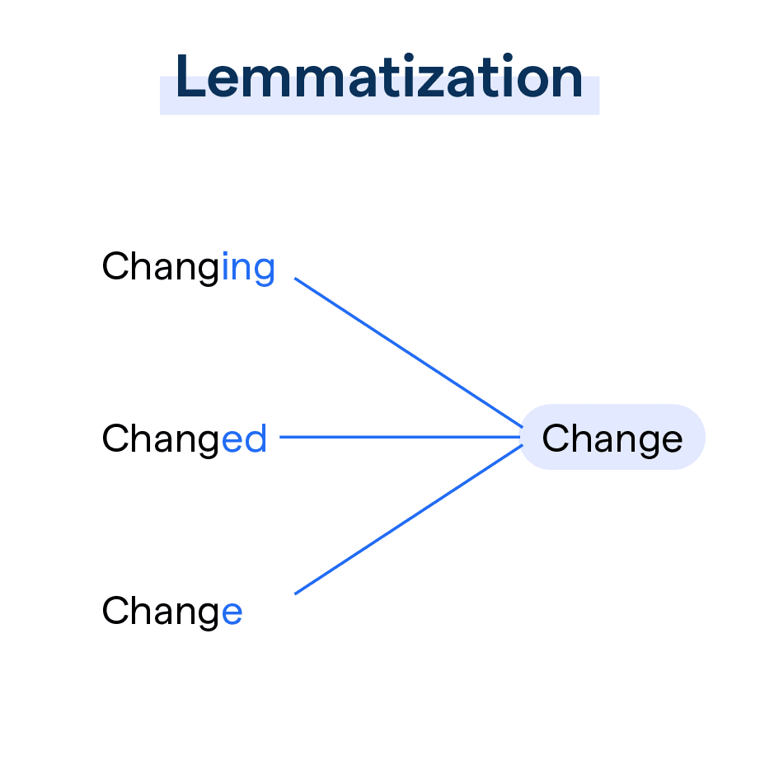


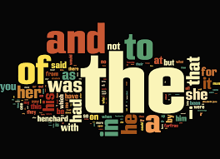
Natural Language Processing
Lower Case
Remove punctuations
Removing stop-words
Word Lemmatization

Slide 17

Conclusion
The best way to classify the self-reported symptoms is by using a good speech-to-text machine and then processing the phrases using NLP and using the frequency of the word in a sentence as features in a model.
In case there is not good speech-to-text machine, then clustering into 2 groups of heavy and light accent and classifying by two different model for each group, results in accurate classification process.

